Slide 1
Lecture 2
Programming Concepts

Slide 2
fig01_02.cpp
(1 of 1) fig01_02.cpp output (1 of 1)
1 // Fig. 1.2: fig01_02.cpp
2 // A first program in C++.
3 #include <iostream>
4
5 // function main begins program execution
6 int main()
7 {
8 std::cout << "Welcome to C++!\n";
9
10 return 0; // indicate that program ended successfully
11
12 } // end function main
Welcome to C++!

Slide 3
Simple C++ Program
  //SimpleProgram.cpp //just a comment
  #include <iostream> //allows use of cout
  using namespace std; //avoids naming conflicts
  int main() //names the method
  { //starts code block for ftn main
  cout << "\nHello World" << endl;
  return 0; //returns zero to operating sys
  } //ends code block for ftn main

Slide 4
Components of a Program
Comments
Preprocessor directives
Function, struct and class definitions
  Statements
    Expressions

Slide 5
Expressions
An expression is a grouping of variables, constants and operators that specifies a computation
An expression results in a value
Examples: amount * 5
(temp -2) * rate
An expression is not a statement
  statements end in a semicolon
  a statement tells the computer to do something
  a statement may include several expressions

Slide 6
Statements
a statement is the basic unit for building C++ programs
most statements are imperative (i.e., tell the computer to do something)
statements end with a semicolon, not with the end of a line (important point!)
Example statements:
  cout << "Hello" ; //statement that does output
  totPay = hourlyRate * numHours + 10.0; //assignment stmt

Slide 7
Lines vs. Statements
the compiler ignores white space (i.e., spaces, tabs, line feeds, carriage returns)
  preprocessor directives should be on one line
  can not break strings between two lines
C++ allows us to write the body of our function main (i.e., our program) as
  cout << "\nHello World" << endl; return 0;
  but this would be difficult to read

Slide 8
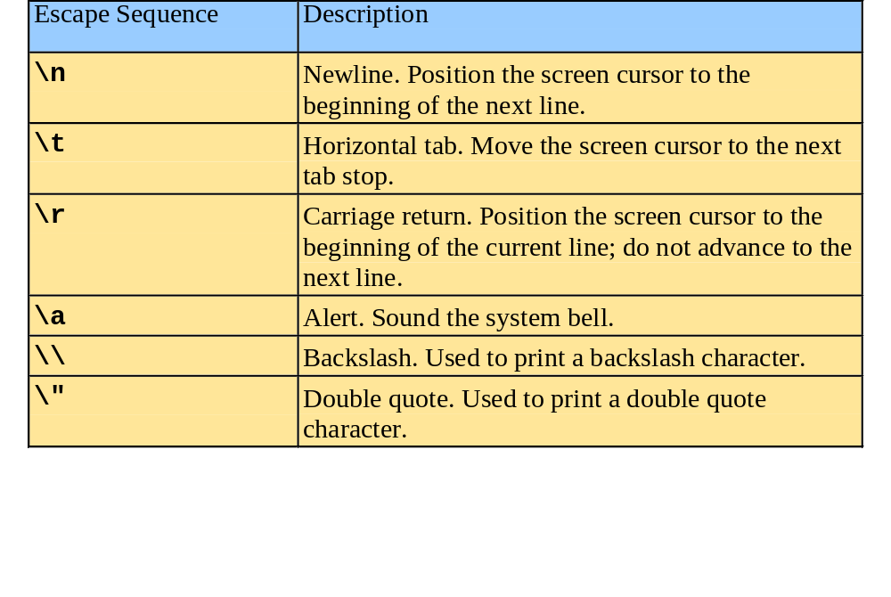
A Simple Program: Printing a Line of Text

Slide 9
Comments
Two methods for designating comments:
  // means ignore everything to the end of line
  /* …. */ means ignore everything between
  the symbols, which can be over
  several lines
Documentation only -- generates no code

Slide 10
Preprocessor Directives
#include <iostream> // note: no semi-colon
include is a directive to the preprocessor (i.e., the compiler, not to C++ itself) to go out and find the file iostream, and include that in the compile process as if it appeared where the include statement is
The system knows where to find the file iostream.
iostream contains function prototypes for functions that manipulate the standard stream input and output objects

Slide 11
Namespaces
using namespace std;
Says all the following lines are in the std namespace
C++ encourages software reuse. Namespaces help avoid naming conflicts
All references will be to names within the std namespace, unless designated differently
All the standard libraries are within the std namespace

Slide 12
Structure of a Function
int main ( )
{
………
}
int -- value returned by function
main -- name of the function
( ) -- contains the argument(s)
{ … } -- code of the function

Slide 13
Inserting into the Standard Output Stream
cout << "\nHello World" << endl;
cout (pronounced see-out) is the standard output stream
<< is the insertion operator
\nHello World is a string of characters
We are inserting the string of characters "\nHello World" into the standard output stream, which will cause the words Hello World to be written on the next line of the monitor
\n is an escape sequence, which will not be printed but will advance to the next line

Slide 14
Return
return 0;
return is the statement that "sends back" the value from the called function to the calling function. In this case the value zero is being sent back by the function main to the Windows operating system

Slide 15
What Happens During Execution
IDE compiles (using preprocessor directives), links, loads and begins execution
control is transferred to function main
main begins execution
  cout statement: the string Hello World is inserted in the standard output stream (i.e., Hello World is displayed on the monitor)
  return statement: the value 0 is sent to the operating system (to indicate successful completion of the program), and then the program terminates

Slide 16
cin >> input_list;
(>> IS THE INPUT OPERATOR)
INPUT OPERATIONS
DATA CAN BE STORED IN MEMORY IN TWO WAYS: THE INPUT STATEMENT OR THE ASSIGNMENT STATEMENT.
cin >> score1 >> score2;

Slide 17
cout << output_list;
(<< IS THE OUTPUT OPERATOR)
OUTPUT OPERATIONS
THE RESULTS OF PROGRAM EXECUTION CAN BE DISPLAYED USING THE OUTPUT STATEMENT.
cout << "The total score is ";
cout << total;
OR
cout << "The total score is "
<< total;

Slide 18
TO ADVANCE THE PRINTING MARKER TO THE START OF THE NEXT LINE, << endl SHOULD BE INCLUDED AT THE END OF A cout OPERATION.
cout << "The total score is "
<< total << endl;
cout << "The letter grade is "
<< letter_grade << endl;

Slide 19
The total score is 185.000
The letter grade is A
DISPLAYS:

Slide 20
Memory Concepts
Variable names
  Correspond to actual locations in computer's memory
  Every variable has name, type, size and value
  When new value placed into variable, overwrites previous value
  std::cin >> integer1;
  Assume user entered 45
  std::cin >> integer2;
  Assume user entered 72
  sum = integer1 + integer2;
integer1
45
integer1
45
integer2
72
integer1
45
integer2
72
sum
117

Slide 21
BASIC OBJECT TYPES
(IN C++)
int
float
char

Slide 22
int
        0
-2002
+15
+0000000000000015 = 15

Slide 23
Float
23.4
3.456
-7.890
DIGITS OF ACCURACY (PRECISION)
AND MAGNITUDE
EXAMPLE:
1,234,567,890
CAN BE REPRESENTED AS
1234568x10
(WITH 7 DIGITS OF ACCURACY.)
3

Slide 24
char
ALPHANUMERIC CHARACTERS INCLUDE
LETTERS, DIGITS AND SPECIAL SYMBOLS.
( 'a' 'A' '0' '1' '2'
'+' '-' '#' ' ' ) ETC.
EACH CHARACTER IS ENCLOSED IN SINGLE QUOTES.

Slide 25
SYNTAX / SEMANTICS
SYNTAX: RULES TO WRITE VALID INSTRUCTIONS.
SEMANTICS: THE MEANING OF INSTRUCTIONS.

Slide 26
IDENTIFIERS
ARE USED TO NAME THINGS IN C++
(VARIABLE NAMES, FUNCTIONS, ETC.).
SOME ARE DEFINED IN THE LANGUAGE AND
ARE RESERVED FOR SPECIFIC USE
(RESERVED WORDS).

Slide 27
VARIABLE DATA OBJECTS
VALUES THAT ARE IDENTIFIED BY SYMBOLIC NAMES.
MAY CHANGE FROM TIME TO TIME DURING PROGRAM EXECUTION.
EACH VARIABLE NAME IDENTIFIES A STORAGE LOCATION IN THE COMPUTER'S MEMORY.
CAN BE ANY OF THE DEFINED OBJECT TYPES.

Slide 28
NAMING RULES
FIRST CHARACTER MUST BE A LETTER.
LENGTH OF THE NAME CAN VARY, CHARACTERS 2 TO N CAN BE A LETTER, A DIGIT, OR AN UNDERSCORE.
A C++ RESERVED WORD CAN NOT BE USED AS AN IDENTIFIER.

Slide 29
VALID VARIABLE OBJECT NAMES
total
Score1
X
ScoreOne
score_one

Slide 30
NOT VALID VARIABLE OBJECT NAMES
Score One
1score

Slide 31
VARIABLE DECLARATIONS
A statement that associates an
Identifier with an object so that
It may refer to that object
By name.
type variable_name_list;
float total, average;
int score1, score2;
char letter_grade;

Slide 32
CONSTANT DATA OBJECT
Quantities which values do not change
During program execution.
Can be numeric or character type.

Slide 33
CONSTANT VALUES
All numbers, integer and real are constants. So are single characters and series of characters (strings).

Slide 34
NAMED CONSTANT
A SPECIFIED VALUE ASSOCIATED
WITH A CONSTANT NAME (IDENTIFIER).
THIS VALUE CANNOT BE CHANGED
DURING PROGRAM EXECUTION.

Slide 35
CONSTANT DEFINITIONS
const type constant_name = expression;
const char BLANK = ' ';
const float TEST_WEIGHT = 0.25;
const float ASSIGNMENT_WEIGHT = 0.10;
const int MAX_STUDENTS = 100;
const char MESSAGE =
"Invalid data - reenter";
const char FLAG = "true";

Slide 36
EXPRESSIONS
Are made up of variables, constants and operators.
operand
OR
operand operator operand

Slide 37
THE FOLLOWING ARE VALID EXPRESSIONS:
(num + 2) / 3.56
TAX_RATE
test
income * TAX_RATE

Slide 38
ARITHMETIC EXPRESSION OPERATORS
+ ADDITION
- SUBTRACTION
* MULTIPLICATION
/ DIVISION
% DIVISION (MODULUS)
(REMAINDER FROM INTEGER DIVISION)

Slide 39
EXAMPLES:
C++
sum + 5.6
sum * 5.6
sum / value
MATH
SUM + 5.6
SUM x 5.6
SUM
VALUE

Slide 40
EXAMPLES:
EXPRESSION
13 + 16
27 - 12
8 * 15
24.0 / 5.0
9 / 8
7 / 8
9 % 9
7 % 8
9 % 8
0 % 6
VALUE
29
15
120
4.8
1
0
0
7
1
0

Slide 41
PRECEDENCE
LOWEST (LEFT TO RIGHT):
+
-
HIGHEST (LEFT TO RIGHT):
*
/
%

Slide 42
EXAMPLES:
10 / 2 * 4
5
20
5.0 * 3.0 / 10.0 * 3.0
15.0
1.5
4.5

Slide 43
WHEN TWO CONSTANT OR VARIABLE OBJECTS OF THE
SAME TYPE ARE COMBINED USING ONE OF THE
BASIC ARITHMETIC OPERATORS, THE RESULT IS
THE SAME TYPE AS THE OPERAND.
5 + 6 = 11
5.0 + 6.0 = 11.0

Slide 44
INTEGER DIVISION YIELDS INTEGER RESULTS:
8 / 5 = 1
9 / 5 = 1
10 / 5 = 2
REAL DIVISION YIELDS REAL RESULTS:
8.0 / 5.0 = 1.6
9.0 / 5.0 = 1.8
10.0 / 5.0 = 2.0

Slide 45
MODULUS OPERATION YIELDS INTEGER RESULTS:
8 % 5 = 3
9 % 5 = 4
10 % 5 = 0

Slide 46
PARENTHESES
CAN BE USED TO MODIFY THE ORDER OF EVALUATION.
SUBEXPRESSIONS ARE EVALUATED, THE RESULTS ARE COMBINED TO EVALUATE THE COMPLETE EXPRESSION.
THE COMPUTATION OF THE INNERMOST PARENTHESES ARE PERFORMED FIRST.

Slide 47
5.0 * 2 / ( 4 * 2 )
8
10.0
      1.25
5 + 2 / ( 4 * 2.0 )
8.0
0.25
    5.25

Slide 48
( 5 + 3 * ( 2 + 4 / 2 ) + 7 / 2 ) / 3
2
4
12
3
17
20
6

Slide 49
( 5 * ( 11 - 5 ) * 2 ) * 4 + 9
( 5 * 6 * 2 ) * 4 + 9
60 * 4 + 9
240 + 9
249

Slide 50
THE UNARY OPERATORS
+ X
- ( A + B )
N * ( - 2 )
UNARY OPERATIONS HAVE THE HIGHEST PRIORITY.

Slide 51
THE ASSIGNMENT
STATEMENT
variable_name = expression;
THE "=" IS THE ASSIGNMENT OPERATOR.
WHEN THE STATEMENT IS BEING EXECUTED, THE FOLLOWING OCCURS:
1. EVALUATE THE EXPRESSION.
2. PLACE THE VALUE ONTO THE VARIABLE'S STORAGE LOCATION.

Slide 52
ANOTHER EXAMPLE:
ASSUME THE FOLLOWING DECLARATIONS.
float total, average;
int score1, score2, counter;
.
.
total
average
score1
score2
counter
?
?
?
?
?
total, average, score1, score2 AND counter
ARE UNDEFINED.

Slide 53
AND THE CODE SEGMENT:
.
.
cin >> score1 >> score2;
counter = 0;
.
.
total
average
score1
score2
counter
?
?
87
98
0
INITIAL
VALUES
total AND average
ARE STILL UNDEFINED.

Slide 54
.
.
total = score1 + score2;
counter = counter + 1;
.
.
total
average
score1
score2
counter
185.0
?
87 + 98
87
98
1
0 + 1
average IS STILL UNDEFINED.

Slide 55
THE ASSIGNMENT STATEMENT DOES
NOT IMPLY EQUALITY
sum = num;
AND
num = sum;
ARE NOT THE SAME.

Slide 56
sum 123
num 456
sum = num;
sum 456
num 456
sum 123
num 456
num = sum;
sum 123
num 123

Slide 57
Relational Operators
> X > Y X is greater than Y
< X < Y X is less than Y
>= X >= Y X is greater than or equal to Y
<= X <= Y X is less than or equal to Y
== X==Y X is equal to Y
!= X!=Y X is not equal to Y

Slide 58
USING COMMENTS
// comment
OR
/* comment */
// This is a one-line comment
/* This is a comment too,
but a long one */

Slide 59
COMPILER DIRECTIVES
A COMPILER DIRECTIVE IS REPLACED DURING TRANSLATION BY THE NAMED C++ LIBRARY HEADER FILE.
#include <filename>
#include <iostream>

Slide 60
PROGRAM CONSTRUCTION
PROGRAMS BEGIN WITH OPTIONAL COMMENTS TO IDENTIFY THE NAME OF THE FILE IN WHICH THE PROGRAM IS STORED AND A BRIEF DESCRIPTION.
THE COMPILER DIRECTIVES FOLLOW THE COMMENTS.
THE PROGRAM STARTS WITH THE IDENTIFIER main FOLLOWED BY AN OPTIONAL LIST OF PROGRAM'S ARGUMENTS IN THE PARENTHESES ( ) AND THE PROGRAM'S BODY INCLUDED WITHIN THE BRACKETS { }.

Slide 61
// FILE: FindAvg1.cpp
// Finds the average of three test scores
#include <iostream>
using std::cin;
using std::cout;
using std::endl;
void main ()
{
// local data:
const int NUMBER_OF_TESTS = 3;
float test1, test2, test3, average;
// Get the grade marks
cout << "Enter the three test marks: ";
cin >> test1 >> test2 >> test3;
average = (test1 + test2 + test3) /
NUMBER_OF_TESTS;
// Display the average
cout << "The average of the 3 test marks is "
<< average << endl;
return;
}

Slide 62
PROGRAM INTERACTION
Enter the three test marks: 70.0 80.0 90.0
The average of the 3 test marks is 80.000

